Slide 1
University of Akron Applicants and Enrollment Insights
Prachi Shah

Slide 2
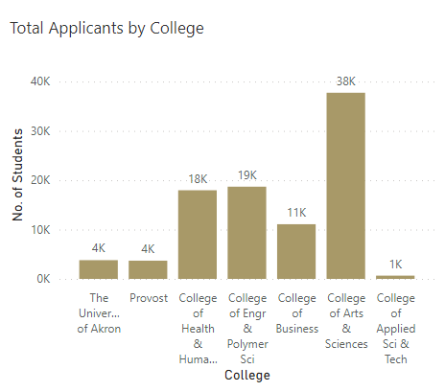
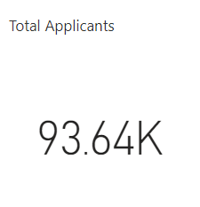
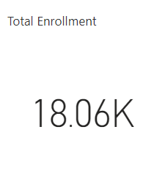
Applications and Enrollment
In the given dataset, out of 93.64K applicants 18.06K are enrolled.
The college with most applications between 2016 and 2021 is College of Arts and Sciences and with least applications is College of Applied Science & Technology
One of the colleges is Provost which is not a college within the University of Akron

Slide 3
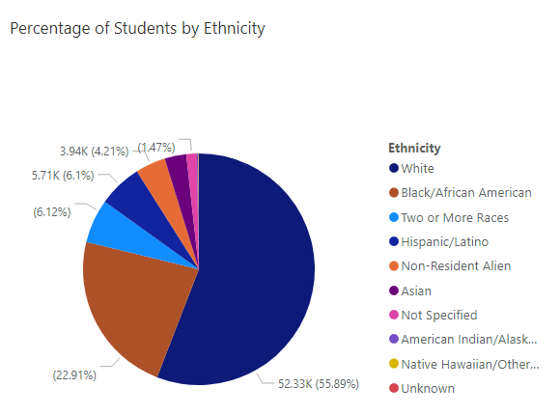
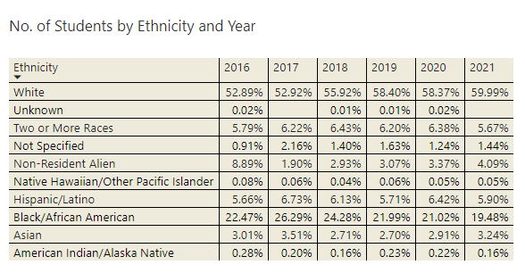
Ethnicity
Most applicants belong to White ethnicity.
The matrix shows the percentage of applicants belonging to a particular ethnicity in all the given years.
The only ethnicity applications that has increased since 2016 to 2021 with a 0.03 percentage points drop in 2020 is White and all other ethnicities have been fluctuating over the time period of 5 years.

Slide 4
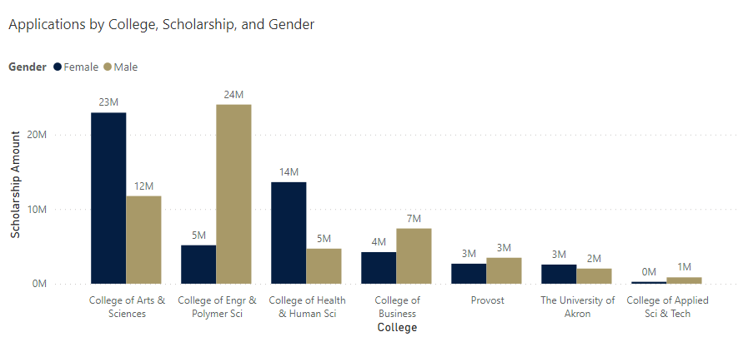
Scholarship and gender
Male applicants within the College of Engineering & Polymer Science are getting the most scholarship opportunities and Female applicants are getting most scholarship opportunities within the College of Arts & Sciences
Growth opportunities – More Scholarship allocation for different colleges and gender
Excluded Intersex and Unknown genders from the bar chart - Outliers

Slide 5
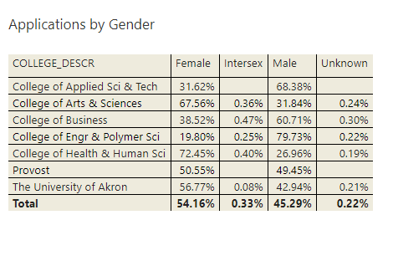
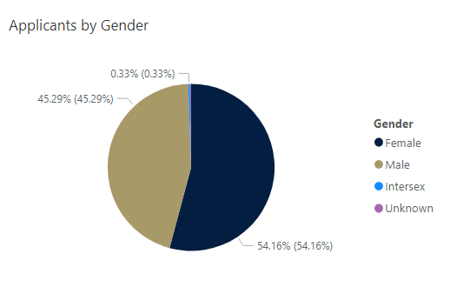
Gender
Some colleges have applicants from other genders as well
Percentage of applicants from other categories of gender are quite low and scholarships allocated to them is almost null
0.33% - Intersex and 0.22% - Unknown

Slide 6
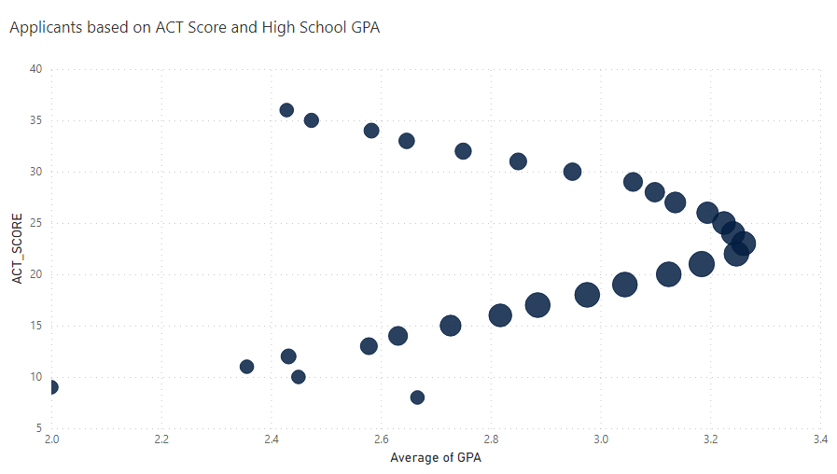
ACT Score and high school GPA
There were 4 outliers – GPA 66 – skewing the data
On average, students with their High School GPA of 3.26 have an ACT score of 26.
Since this is Average GPA, there might be certain factors affecting the analysis of best performing students.

Slide 7
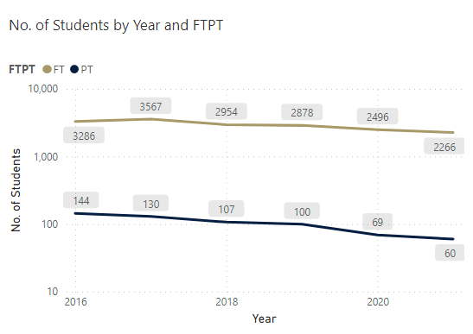
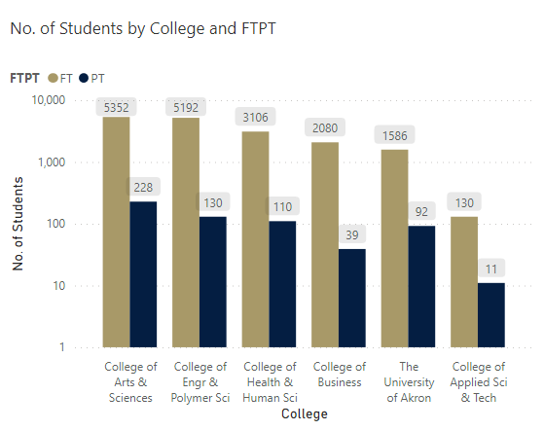
Full Time/Part time
Maximum FT and PT were enrolled in College of Arts and Sciences between years 2016 and 2021 due to CAS having the highest number of applicants and enrollment
The Line chart shows an aggregate of enrolled students based on their enrollment status in all the given years.
The Bar Chart shows an aggregate of enrolled students based on different colleges.

Slide 8
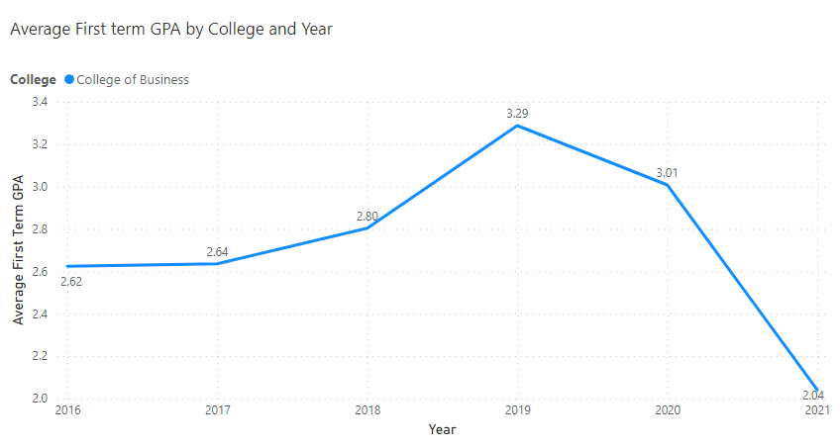
First Term GPA
The line chart shows Average first term GPA of all enrolled students between 2016 and 2021.
I have added 2 slicers: College and Departments – if we want to figure out which departments within a college are impacting the average GPA the most, we can do so by selecting different departments.
Open in Power BI 12 Data as of 2/28/23, 8:33 AM Filtered by College (is College of Business), DEPARTMENT_DESCR (is Dept of Economics)

Slide 9
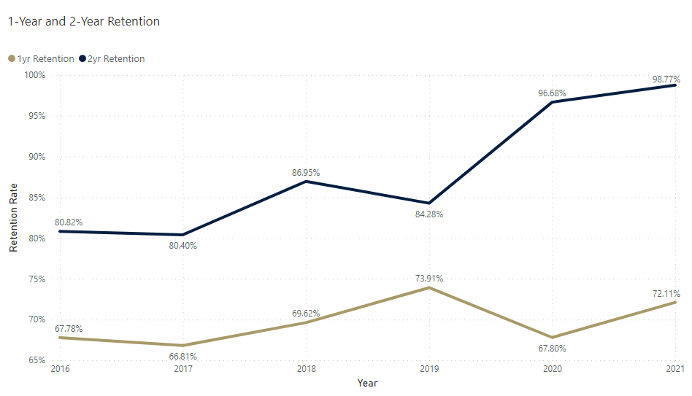
Retention
I forecasted 1-year and 2-year retention count and retention rate in Excel.
In 2021, out of 2327 students, the forecasted 1-year retention is of 1678 students which means the retention rate is 72.11%.
Based on 1-year retention, 2-year retention can be forecasted and for 2020 it is 96.68% and 2021 it is 98.77%.
Year | No. of Students | 1-Year Retention | Retention Rate (1 yr) | 2-Year Retention | Retention Rate (2 yr)
2016 | 3430 | 2325 | 67.78% | 1879 | 80.82%
2017 | 3697 | 2470 | 66.81% | 1986 | 80.40%
2018 | 3061 | 2131 | 69.62% | 1853 | 86.95%
2019 | 2978 | 2201 | 73.91% | 1855 | 84.28%
2020 | 2565 | 1739 | 67.80% | 1681 | 96.68%
2021 | 2327 | 1678 | 72.11% | 1657 | 98.77%

Slide 10
Steps to support stakeholders
Focus on distributing more or equal scholarships to diverse groups to increase the enrollment
Merging multiple programs to improve overall enrollment within a college (i.e., College of Applied Science & Technology)
Focusing on DEI and introducing resource groups for students as well as faculty (decline in some ethnicities in 2021)
Even though the retention rate is higher in 2021, there is a decline in number of students due to lower enrollment (focus more on retaining students)

Slide 11
Thank You
Prachi Shah

